Slide 1
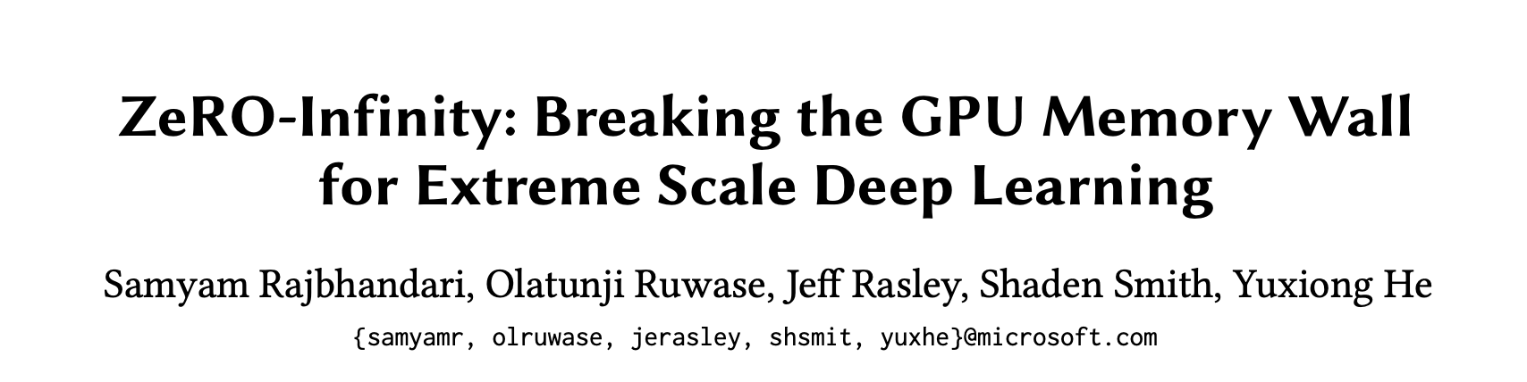
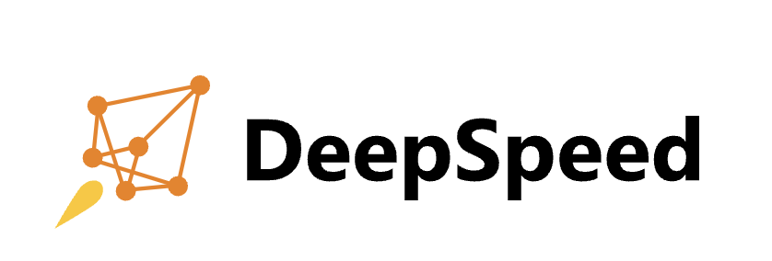
Presented by Xinyi Song and Nikhil Kanamarla

Slide 2
Motivation
Push the size of model to infinity!

Slide 3
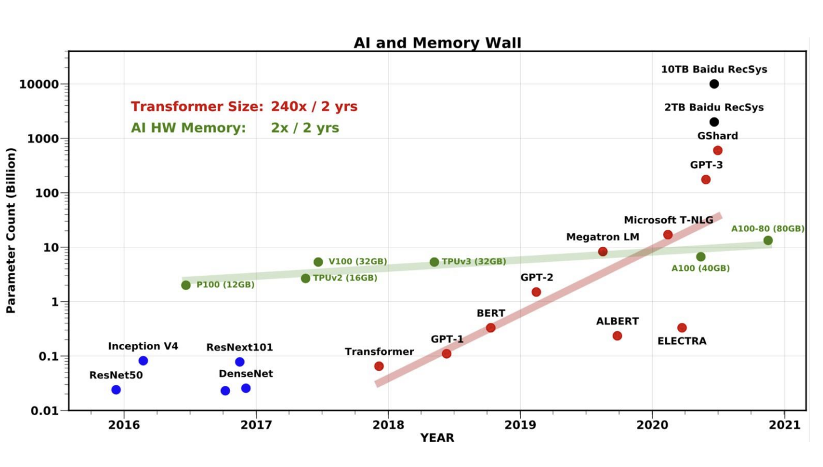
Background
GPU memory wall
Amount of parameters increase in almost exponential growth with GPU memory increasing slower.
Existing Work
Have reached trillion size model, but can it be larger?
Notes:
It requires 800 NVIDIA V100 GPUs just to fit a trillion parameter model for training

Slide 4
The factors that limit the size growth of LLMs
Memory and Storage Limitations
model states (parameters, gradients, optimizers)
residual memory (activations)
Bandwidth and Communication Constraints
Parameter and gradients,
Optimizer state
Activation memory
Computational Resource Constraints
Training Efficiency and Algorithmic Constraints
……

Slide 5
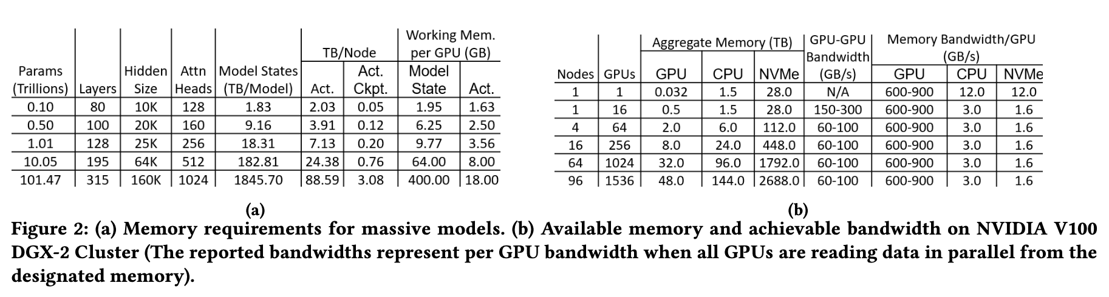
Memory Requirement
Just for putting model to GPUs:
1T parameter model -> 512 GPUs,
10T parameter model -> >1536 GPUs.
To deal with over Trillion parameter model, Model State need to be separated
Notes:
Figure 2a column 7 shows the memory required to store activation checkpoints for batch size of 32 and sequence length of 1024 assuming we store one activation per Transformer block.
Figure 2a column 5 shows the memory required to store the model states of a GPT-3 like Transformer based model with 100 billion to a 100 trillion parameters created by varying hidden dimension and number of layers.
Figure 2b column 3 shows the aggregate GPU memory available on a single NVIDIA V100 DGX-2 box as well as a DGX- 2 SuperPOD cluster.
Figure 2a column 8 shows that AWM gets large beyond 10 trillion parameters, even with 𝑐𝑖 = 1.

Slide 6
Existing Work - 3D Parallelism
Is able to reach trillion size model by
Combines data, model, and pipeline parallelism to leverage the strengths of each approach.
However
Significant model code refactoring
Not suitable for models with complex dependency graphs
The model size is limited by the total available GPU memory
Notes:
Models with complex dependency graphs are difficult to be expressed into load-balanced pipeline stages

Slide 7
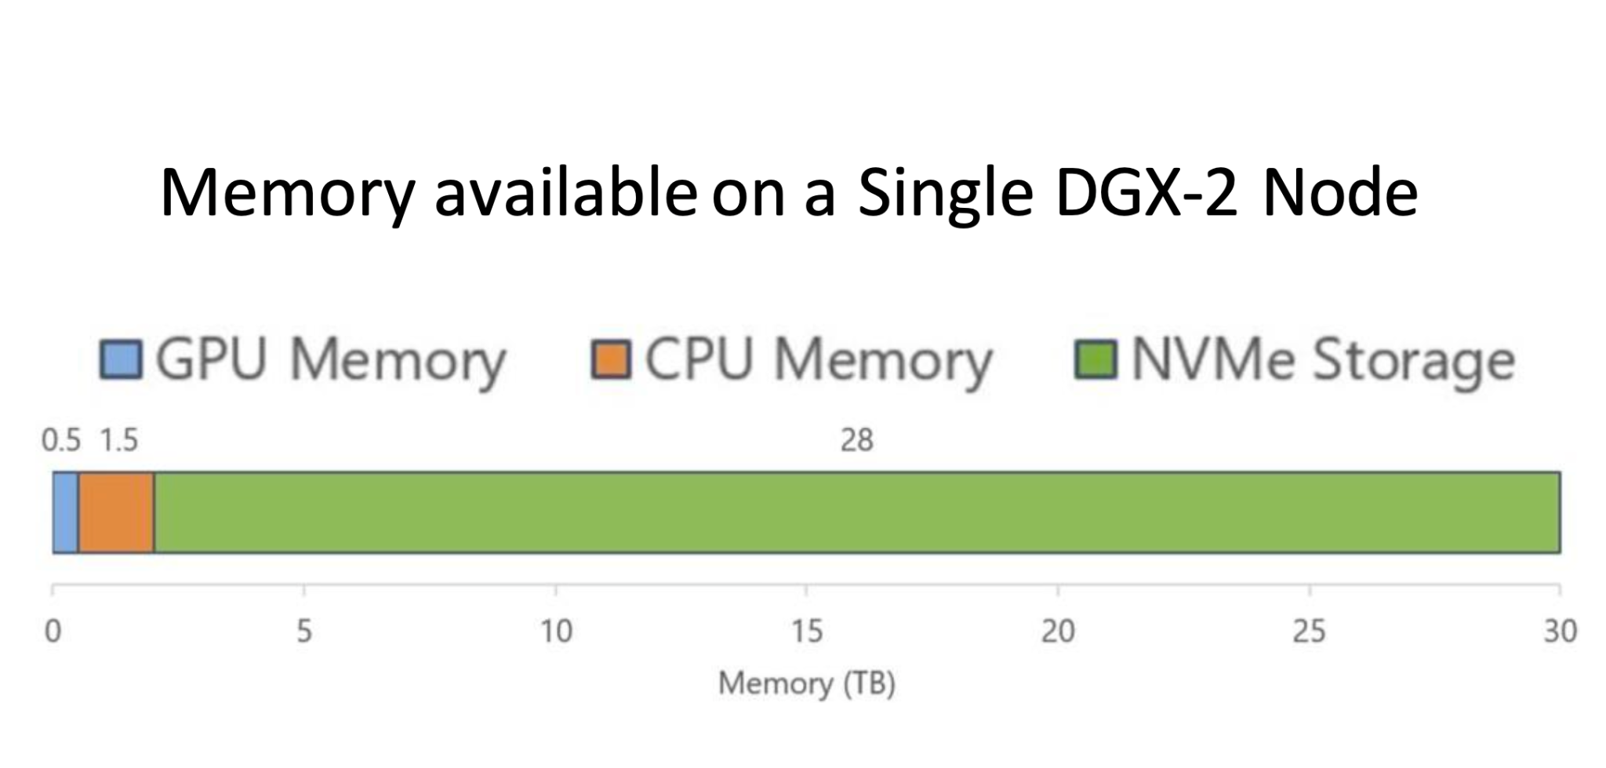
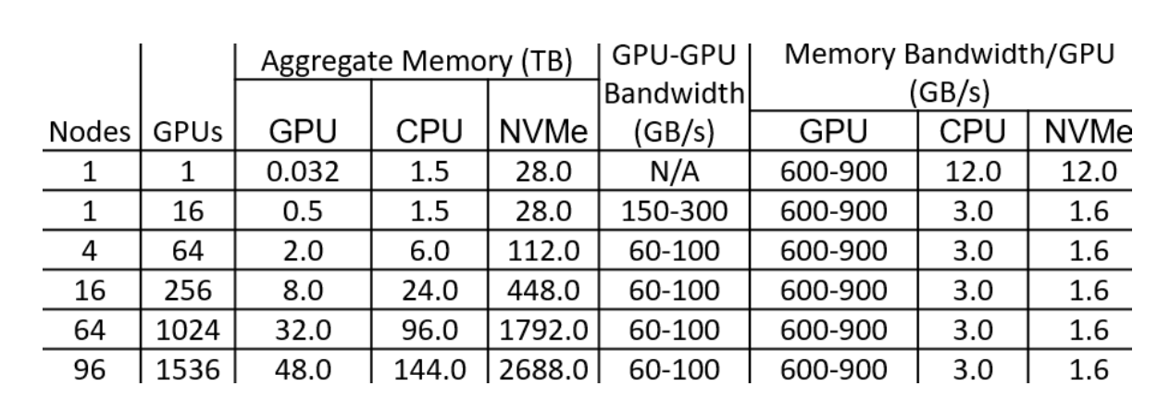
Use CPU/NVMe memory!
Need to consider the limited bandwidth between CPU/NVMe and GPU
Notes:
This represents the classic systems capacity versus speed tradeoff

Slide 8
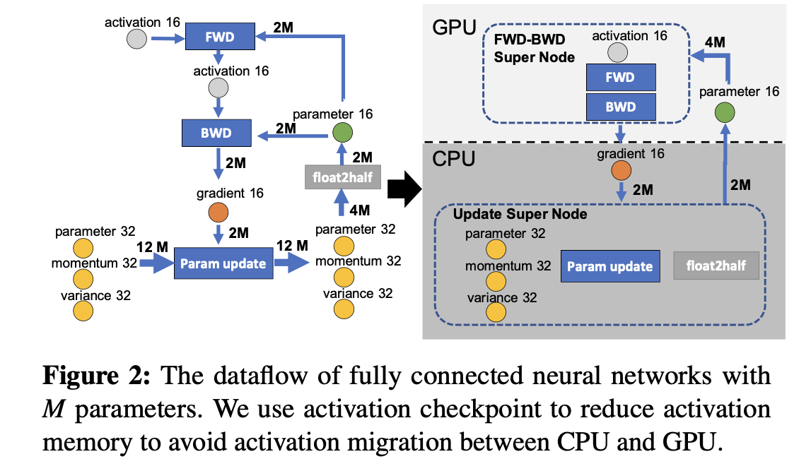
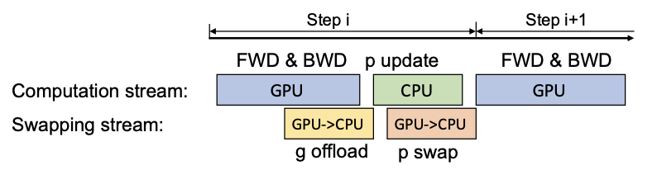
Existing Work - ZeRO-offload
Built on top of ZeRO-2 and stores the gradients and the optimizer states in CPU memory.
FP16 data send between CPU and GPU to reduce communication due to limited bandwidth.
Why still limited model size?
Still stores the parameters and gradients in GPU memory replicate them across all devices
Needs offload/swap the Gradient/Parameter of all layers and passing data step by step -> model size limited by the bandwidth
Notes:
It still needs to store the parameters in GPU memory and replicate them across all devices. ZeRO-Offloading mechanism also requires larger batch sizes to remain efficient due to suboptimal data partitioning and limited PCIe bandwidth.

Slide 9
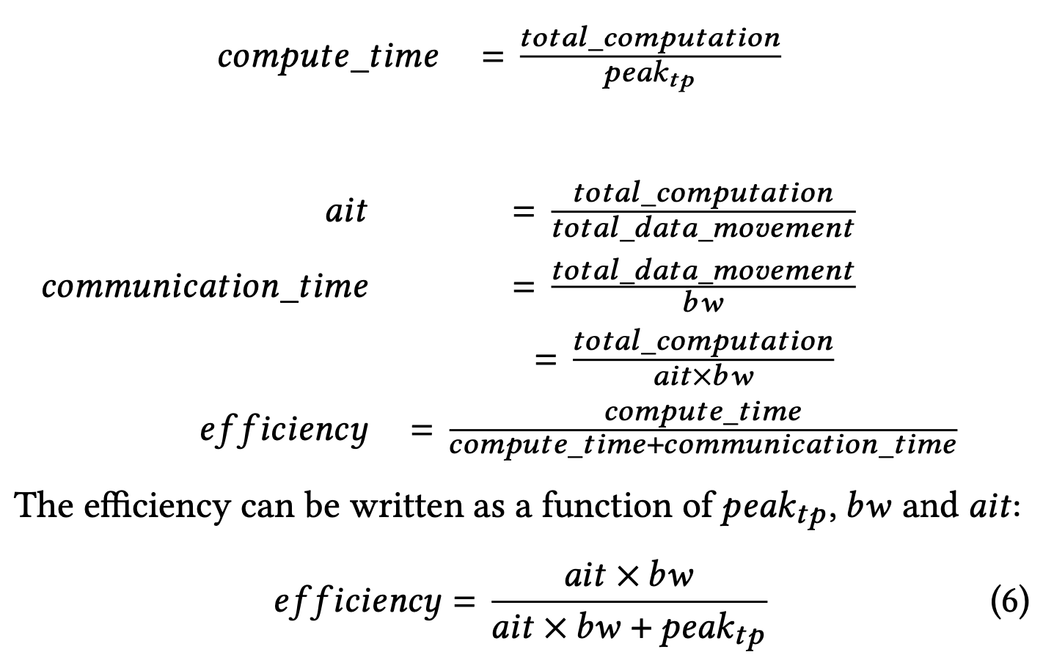
Bandwidth Requirement
Whether offloading to CPU/NVMe memory will hurt training efficiency?
If the efficiency >= 50%, the data movement in theory can be completely overlapped with the computation
Model states and activation checkpoints can have varying 𝑎𝑖𝑡
AIT (arithmetic intensity,amount of computation per data movement)
Peak_{tp} (Peak computational throughput)
BW (data movement bandwidth)

Slide 10
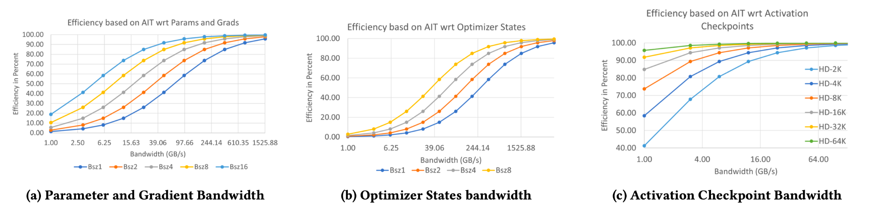
Bandwidth Requirement
Pic (a) Parameter and gradients
bandwidth of over 70 GB/s for parameter and gradients, we can achieve over 50% efficiency
Pic (b) Optimizer states
require nearly 4x higher bandwidth to achieve 50% efficiency compared to parameters and gradients.
updated at the end of the forward and backward propagation and cannot be overlapped with the computation.
Pic (c) Activation memory
bandwidth of 2 GB/s is able to sustain over 50% efficiency even for a hidden size of 2𝐾.
Notes:
Shows the relationship between efficiency and available bandwidth for a given data type with different graphs due to varying AIT. AIT varies for model states depending on batch size and sequence length and varies for activation checkpoints based on the frequency of checkpointing and the hidden dimension size of model.
Experimental design: Computed AIT based on varying batch size 1-16, sequence length of 1024, hidden size from 8K-64K using different size models from billions to trillions of parameters.
Hardware used: NVIDIA V100 DGX-2 SuperPOD cluster
Optimizer states are updated at the end of the forward and backward propagation and cannot be overlapped with the computation. As a result they require significantly larger bandwidth to keep the overall DL workload efficient. For example achieving 90% efficiency with batch size of 2 per GPU requires nearly 1.5 TB/s of effective bandwidth, which is greater than even the GPU memory bandwidth.

Slide 11
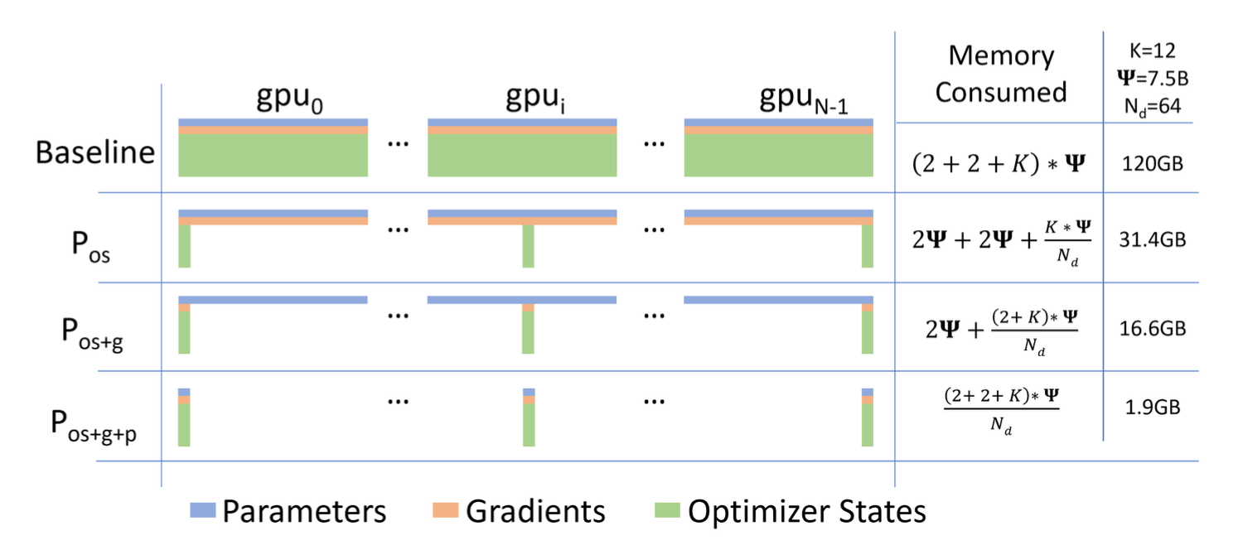
Existing Work - ZeRO Redundancy Optimizer
Data parallelism for reducing memory redundancy.
ZeRO-1: Partitions optimizer states across devices.
ZeRO-2: Partitions both optimizer states and gradients.
ZeRO-3: Partitions optimizer states, gradients, and parameters, allowing the model to scale even further.
Each GPU stores a mutually exclusive subset of the model state.
Notes:
ZeRO requires that all model states fit in the aggregate GPU memory

Slide 12
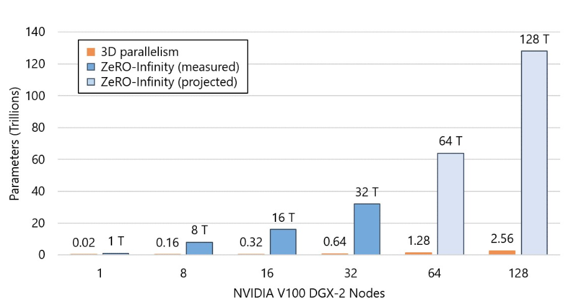
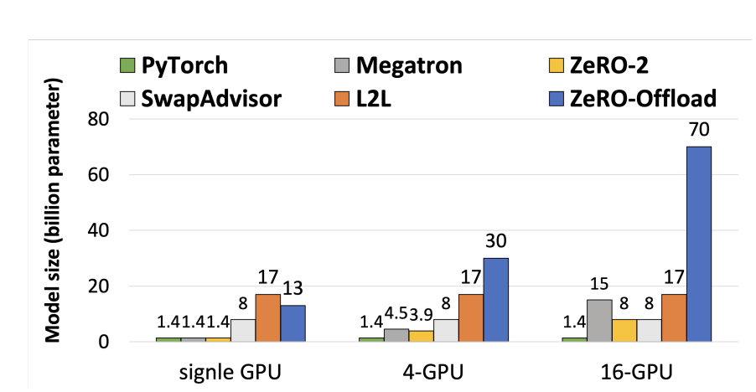
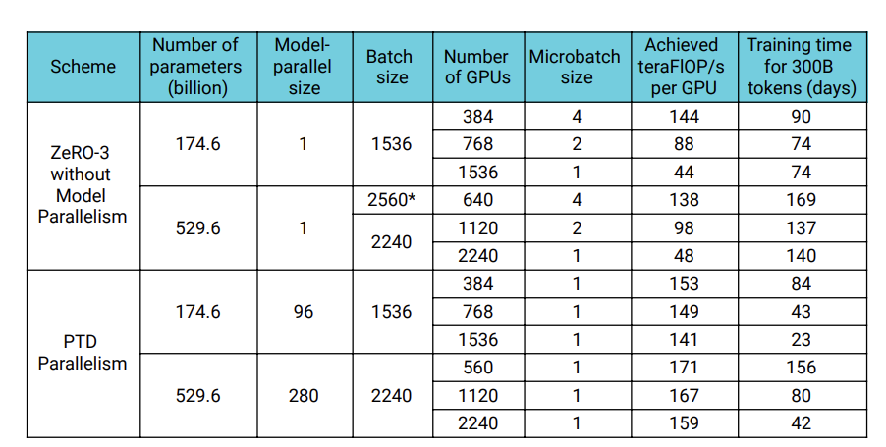
ZeRO-Infinity: Train a model with 10+ trillions of parameters
By finer slicing P & G (offloading layer by layer), ZeRO-Infinity provide more opportunity for overlapping offloading/swapping with computation
-> Overlap centric design

Slide 13
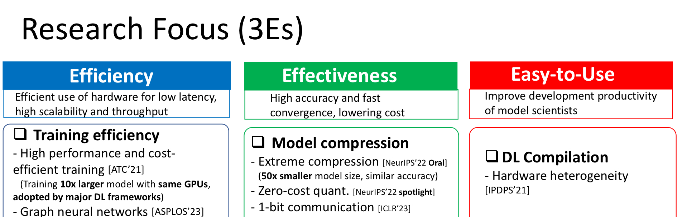
ZeRO-Infinity Overview
Scale to 10T+ parameter models on existing hardware without sacrificing model performance with reasonably good throughput.
Approach: ZeRO-3 with heterogeneous hardware.
Little model developer effort to use it through Pytorch or DeepSpeed

Slide 14
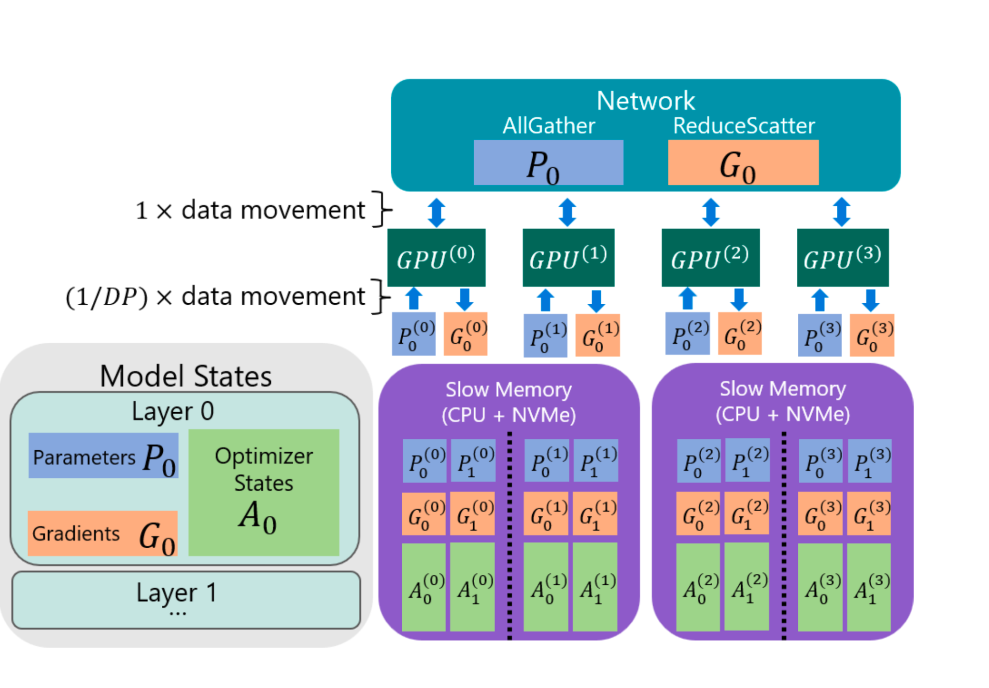
Key Ideas Part 1: Infinity Offload Engine
Heterogeneous memory access: GPU Memory, CPU Memory, NVMe Disk used to store model states (ZeRO-3) dynamically and CPU offload for activation checkpointing.
DeepNVMe Library: High performance C++ library for asynchronous, bulk read write requests to NVMe storage.
Pinned memory management: Avoids unnecessary copying and memory fragmentation for faster copying between CPU/NVMe to GPU devices.
Notes:
**Overview:**
The Infinity Offload Engine is a core component of ZeRO-Infinity, designed to manage and optimize the offloading of large amounts of data between GPU, CPU, and NVMe memory. Its main goal is to enable the training of models that are too large to fit entirely in GPU memory by leveraging the combined memory of CPUs and NVMe storage.
**Key Features and Design Choices:**
- **Heterogeneous Memory Access:** The engine allows data (such as model parameters, gradients, and optimizer states) to be stored across GPU, CPU, and NVMe memory, dynamically deciding where to place data based on the memory requirements and access patterns. CPU Offload for activations. To avoid running out of memory, we can use activation checkpointing, where instead of storing all activations, we only store them at specified intervals to save memory at the expense of activation re-computation in the backward pass. Activation checkpointing can reduce the activation memory footprint by orders of magnitude. However, for massive models, the memory requirement after activation checkpointing can still be too large to fit in GPU memory. To address this, we support activation checkpointing with CPU offload, allowing all the activation to reside in the CPU memory.
- **DeepNVMe Library:** A high-performance C++ library within the Infinity Offload Engine, which handles bulk read and write requests to NVMe storage with high parallelism. It supports asynchronous operations, allowing overlap between data movement and computation.
- **Pinned Memory Management:** To ensure efficient data transfer, the Infinity Offload Engine uses pinned memory buffers that are recycled to prevent memory fragmentation. This is critical when transferring data between GPU and CPU/NVMe, as pinned memory allows for faster data movement by avoiding unnecessary copying and minimizing system resource usage.

Slide 15
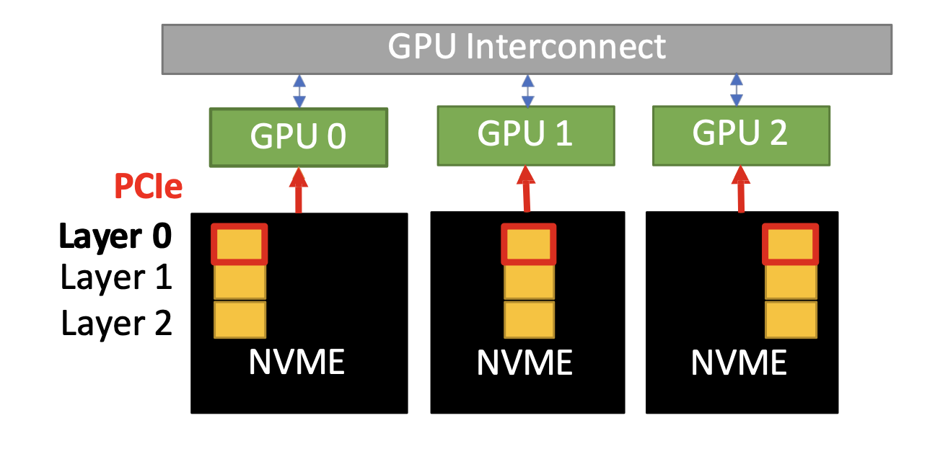
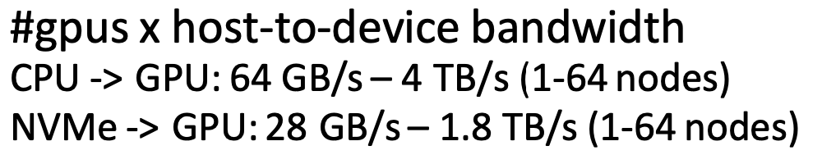
Key Ideas Part 2: Bandwidth centric partitioning
Partitioning: Distributions model states across data parallel processes.
Aggregate Bandwidth utilization: Uses all-gather to enable all GPUs to fetch only the portions of the data it needs in parallel.
Memory centric tiling: Layers are broken down into a subset of operations using tiling and executed sequentially reducing working memory pressure.
Notes:
**Overview:**
Bandwidth-Centric Partitioning addresses the challenge of limited bandwidth between GPU, CPU, and NVMe, which can bottleneck training performance. This strategy optimizes how data is partitioned and moved between these components to maximize effective bandwidth. For instance, the NVMe bandwidth is about 25 GB/sec per DGX-2 node, but on a cluster with 64 such nodes, this increases to 1.6 TB/sec, even faster than the GPU HBM2 memory on the NVIDIA V100 GPU that can achieve 0.9 TB/sec. Bandwidth grows linearly with the number of nodes.
**Key Features and Design Choices:**
- **Partitioning Model States Across Devices:** Instead of having each data parallel process fully own the optimizer states or parameters or gradients, ZeRO-Infinity partitions these states across all participating GPUs. This approach ensures that data is more evenly distributed and managed across the system. Each data parallel process has 1/dp portion of the model states where dp is the data parallel degree. This eliminates the the data redundancy of traditional data parallelism.
- **All-Gather for Data Retrieval:** By using all-gather collectives rather than traditional broadcast methods, ZeRO-Infinity allows each GPU to fetch only the portions of the data it needs. This method leverages the aggregate bandwidth of all GPUs, effectively multiplying the available bandwidth by the number of GPUs involved. The difference between these methods increases the CPU/NVMe to GPU achievable bandwidth from 12 GBs to 48 GBs per DGX node.
**Overview:**
Memory-Centric Tiling is a technique designed to handle large model layers that cannot fit into GPU memory as a single unit. This technique segments these large layers into smaller, more manageable tiles, allowing them to be processed sequentially avoiding the need for model parallelism. When combined with ZeRO-3, which can gather and remove parameters on demand, this tiling reduces the working memory proportional to the number of partitions, supporting arbitrarily large hidden sizes that would otherwise require model parallelism to fit even a single model layer. This technique allows ZeRO-Infinity to train models with very large individual layers that would otherwise not fit in GPU memory, even temporarily. By using memory-centric tiling, the need for complex model parallelism is reduced, simplifying the training setup and making it more accessible for users.
**Key Features and Design Choices:**
- **Tiling Large Operators:** Large neural network layers, such as fully connected layers with millions or billions of parameters, are broken down into smaller "tiles." Each tile represents a subset of the full layer's operations and is executed independently.
- **Sequential Execution of Tiles:** Instead of processing the entire layer in one go (which would exceed memory capacity), ZeRO-Infinity processes these tiles one at a time. This sequential processing reduces the peak memory required at any given moment.
- **Integration with ZeRO-3:** Memory-centric tiling works in conjunction with ZeRO-3's data movement strategies, fetching and releasing only the required tiles when needed. This minimizes the time that large amounts of data reside in GPU memory, tiling reduces the working memory proportional to the number of partitions.

Slide 16
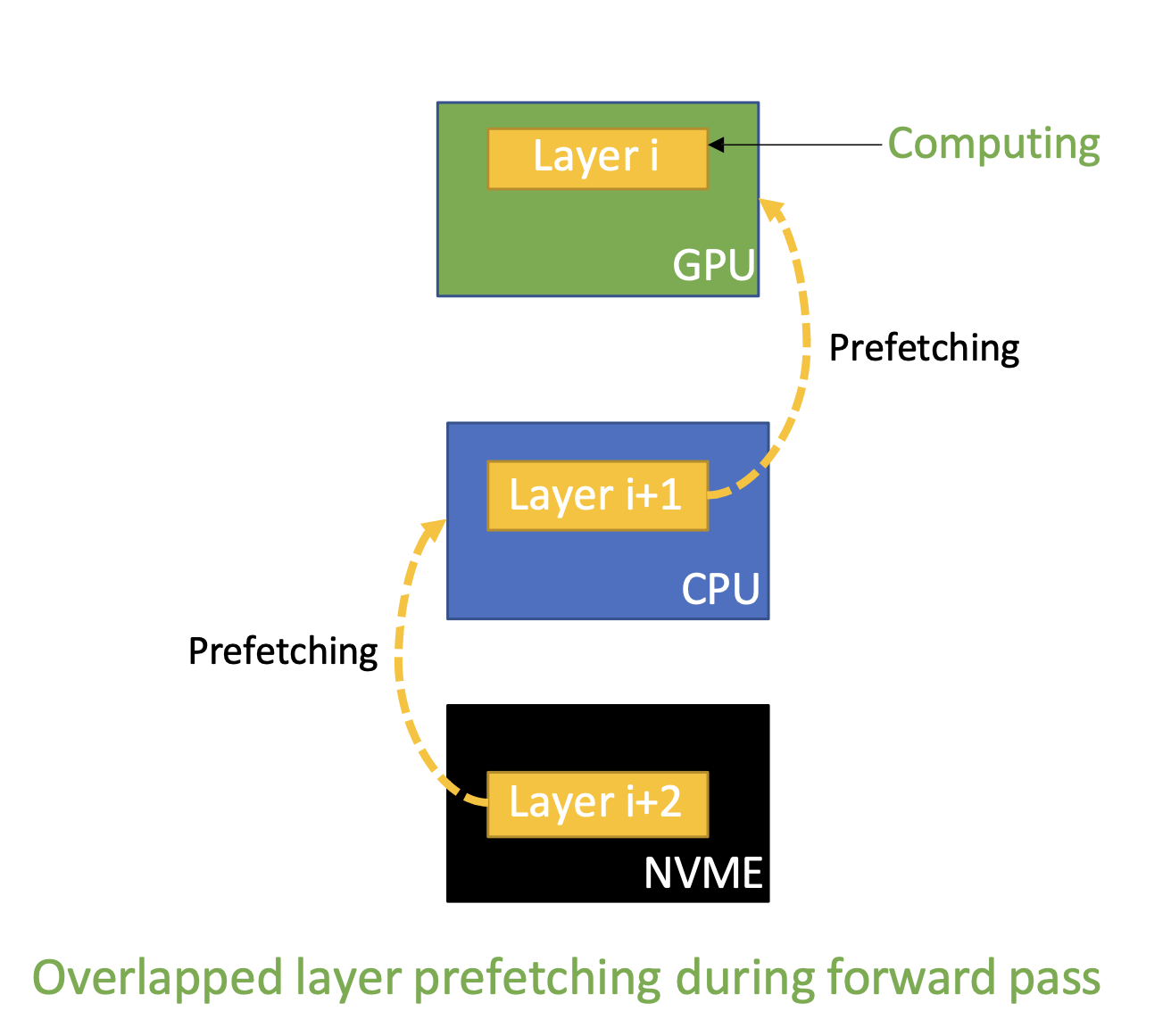

Key ideas Part 3: Overlap centric design
Dynamic fetcher: Tracks the operations in each pass in real-time and gathers the necessary data for the upcoming operation.
Three-tiered overlapping: Moves data between NVMe to CPU, CPU to GPU and then GPU to GPU overlapped with computation.
Notes:
### 4. **Overlap-Centric Design**
**Overview:**
The Overlap-Centric Design in ZeRO-Infinity focuses on overlapping data transfers (between GPU, CPU, and NVMe) with computation, minimizing idle times and maximizing resource utilization. This design is crucial for maintaining high training efficiency despite the slower speeds of CPU and NVMe memory compared to GPU memory.
**Key Features and Design Choices:**
- **Dynamic Prefetching:** ZeRO-Infinity uses a dynamic prefetcher that tracks the sequence of operations in real-time. It prefetches the necessary data for upcoming operations before they are executed in the backward or forward pass, ensuring that data is available in GPU memory just in time for computation. For instance, before executing the 𝑖𝑡h operator, the prefetcher can invoke nc, cg, and gg-transfer for parameters required by 𝑖 + 3, 𝑖 + 2, and 𝑖 + 1 operators, respectively. Note that all of these data movement can happen in parallel with the execution of the 𝑖𝑡h operator.
- **Three-Tiered Overlapping:** The overlap design simultaneously manages three levels of data movement:
1. **NVMe to CPU (nc-transfer):** Data is preemptively moved from NVMe storage to CPU memory.
2. **CPU to GPU (cg-transfer):** Concurrently, data needed immediately is transferred from CPU to GPU.
3. **GPU to GPU (gg-transfer):** Lastly, within the GPU network, all-gather collectives assemble the required data from all GPUs for the forward.
Forward: All gather of parameters to GPU, compute activations on GPU and store on GPU memory (temporarily with off-loading to CPU if needed)
Backward: All gather of parameters to GPU, compute gradients on GPU, reduce-scatter gradients (GPU->CPU->NVMe).
Update: Move parameters and gradients to CPU, Update parameters on CPU, Move parameters to NVMe.
- **Parallel Processing:** By overlapping these transfers with ongoing computations, ZeRO-Infinity minimizes the time spent waiting for data and maximizes the utilization of computational resources.
**Impact on Training:**
The Overlap-Centric Design enables ZeRO-Infinity to maintain high computational efficiency by hiding the latency of data transfers behind the ongoing computation. This design is particularly effective in setups where heterogeneous memory (NVMe and CPU) would otherwise introduce significant delays, ensuring that training throughput remains high even when working with extremely large models. With larger batch sizes, there is more computation available to overlap with communication but it may slow down convergence. When batch sizes are small, there may not be enough computation to fully mask the data transfer times, leading to inefficiencies as the GPUs may have to wait for data.
Notes on communication collectives
1. All-Gather
All-Gather is a communication collective operation that collects data from all participating processes and distributes the complete set of collected data to all processes. Here's a more detailed explanation:
Purpose: All-Gather is used when each process has a piece of data (often a vector or tensor), and the goal is for every process to receive the full set of data from all other processes.
How it works:
Each process contributes its own chunk of data.
These chunks are then gathered and combined into a single, larger data set, which is then sent back to all processes.
As a result, each process ends up with a complete copy of the entire data set, which includes contributions from every other process.
For example, if there are four processes (P0, P1, P2, P3), and each process has its own data chunk, after All-Gather, each process will have the combined data of all chunks [chunk0, chunk1, chunk2, chunk3].
Use Case: Commonly used in distributed deep learning for synchronizing gradients or intermediate results across all processes.
2. Reduce-Scatter
Reduce-Scatter is a communication collective operation that performs a reduction (like summation, averaging, or other operations) across data from all participating processes and scatters the results to all processes. Here's a detailed explanation:
Purpose: Reduce-Scatter combines data from all processes using a specified reduction operation and then distributes parts of the reduced result back to each process.
How it works:
Each process starts with its own data chunk.
These chunks are first reduced using an operation (like sum, max, or min), combining corresponding elements across processes.
The final reduced result is then divided into equal parts (one per process), and each part is sent to the corresponding process.
For example, if there are four processes (P0, P1, P2, P3), each with its own data chunk, and the reduction operation is a sum, Reduce-Scatter first computes the sum of corresponding elements across all processes and then sends a portion of the reduced result back to each process.
Use Case: Often used in distributed training to aggregate gradients or other values and distribute the aggregated results across the participating processes.

Slide 17
Key ideas Part 4: Ease of use
Implemented on top of Pytorch and available through the DeepSpeed library.
Requires only mild training script changes from the user.
Automates data movement of model states by injecting hooks into Pytorch modules to trigger communication collectives and offloading.
Automates model partitioning by wrapping the constructor such that each parameters offloaded immediately after initialization.
Notes:
ZeRO-Infinity is implemented on top of PyTorch and only requires mild training script changes from the user. ZeRO-infinity is available through the DeepSpeed library.
i) automated data movement (automatic registration of parameters) to gather and partition parameters right before and after they are required during the training. ZeRO-Infinity does this by recursively injecting i) pre forward/backward hooks into PyTorch submodules that trigger all-gather collectives to collect the parameters required before its forward/backward pass and ii) post forward/backward hooks that trigger parameter/gradient partitioning and optionally offloading them to CPU or NVMe.
ii) automated model partitioning during initialization such that models that can not fit within single GPU or CPU memory can still be initialized without requiring manual partitioning of the model across data parallel processes. ZeRO-Infinity achieves this by wrapping the constructor of all module classes so that parameters of each submodule are partitioned and offloaded immediately after they are created during initialization. The entire model is never fully instantiated on a single data parallel process. For example, a 500 billion parameter model will occupy 1 TB of memory in half precision, and thus a system with 8 GPUs per node requires 8 TB of aggregate CPU or GPU memory just for the initial data parallel allocation step. In order to improve user experience, they also provide mechanisms to detect when parameters are used across model boundaries and automatically register external parameters so the the user does not have to make any code change.

Slide 18
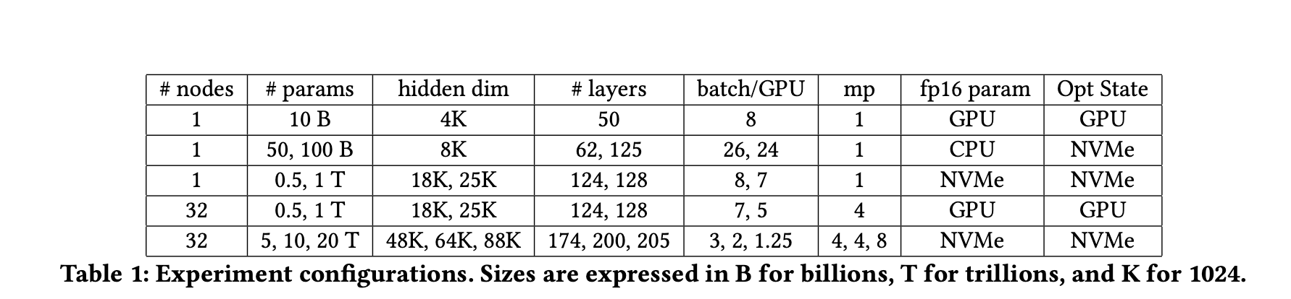
Experimental design
Hardware: Up to 32 DGX-2 nodes with 800 Gbps of internode bandwidth
Baseline: Torch DDP, Megatron-LM, ZeRO, ZeRO-Offload
Model: Large transformers with sequence length of 1024
Notes:
Hardware. We conducted our experiments on a cluster of up to 512 V100 SXM3 32 GB GPUs (32 DGX-2 nodes) with 800 Gbps internode communication bandwidth.
Baseline. For experiments without model parallelism (mp), we use torch’s distributed data parallel (DDP [42]) as a baseline. For experiments with model parallelism, we use Megatron-LM [7] and for data parallelism we use ZeRO [11], or ZeRO-Offload [12].
Model Configurations. We use GPT-like Transformer based models. We fix the sequence length to 1024 and vary the hidden dimension and number of layers to obtain models with different number of parameters.

Slide 19
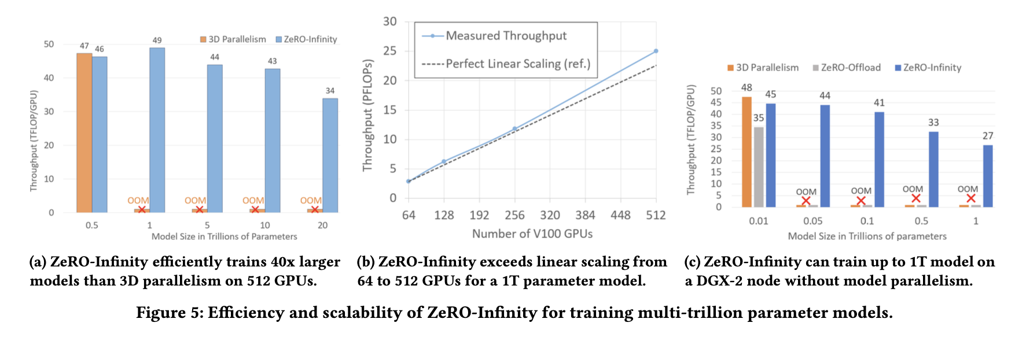
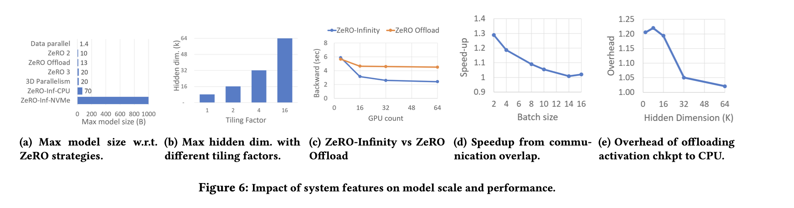
Experimental results
Model size
Model throughput
Scalability
Model accessibility
Notes:
Model Size and Speed:
Model Size: ZeRO-Infinity successfully trains models with over 32 trillion parameters on a 512 GPU cluster (V100 SXM3 32 GB GPUs (32 DGX-2 nodes) with 800 Gbps internode communication bandwidth), achieving a 50x increase in scale compared to the 650 billion parameter limit of 3D parallelism.
Model Throughput: The system maintains decent training throughput even at extreme scales. For a 500 billion parameter model, it matches the performance of 3D parallelism and continues to efficiently train models up to 20 trillion parameters with a throughput of up to 49 TFlops/GPU. This throughput drop at 20 trillion parameters to 10 TFlops/GPU is not due to NVMe bandwidth as both model sizes use NVMe offload, but instead due to an extremely small batch size per GPU at 20T scale as a result of limited CPU memory to store activation checkpoints.
Superlinear Scalability:
Scalability Performance: ZeRO-Infinity achieves superlinear scalability (weak scaling) when training a 1 trillion parameter model as the number of nodes increases from 64 GPUs to 512 GPUs. This is due to better utilization of aggregate bandwidth from additional nodes and leveraging CPU compute from additional nodes for parameter updates, allowing it to exceed perfect linear scaling.
Accessibility of large Model Training:
Single Node Training: ZeRO-Infinity can train models up to 1 trillion parameters on a single DGX-2 node (16 GPUs) without requiring model parallelism although at much slower throughput. This making such training accessible to researchers without access to large clusters.
Diagrams
One a single DGX-2 node, data parallelism only allows for 1.4 billion parameters and 3D parallelism allows for 20 billion parameters. ZeRO-Infinity allows scaling to 1T trillion parameters and this final major jump in scale comes from offloading model states to NVMe.
ZeRO allows for training a massive hidden size of 64K using memory-centric tiling factor of 16.
ZeRO-Infinity leverages the aggregate PCIe bandwidth across GPUs to offload the gradients, resulting in a speedup of nearly 2x at 64 GPUs compared to ZeRO-Offload which is limited by single PCIe bandwidth decreasing the time for a backward pass.
Prefetching and overlapping benefit diminishes at larger batch sizes due to communication becoming a bottleneck.
CPU offloading overhead gets smaller as the hidden dimension gets bigger.

Slide 20
Discussion and Future work
Benefits: Exceeding GPU memory capacity without manual model changes.
Drawback 1: Reliant on high bandwidth of heterogeneous devices in GPU clusters. Model checkpointing may temporarily saturate NVMe bandwidth decreasing training time.
Future work 1: Communication volume may need to reduce for even larger models or less capable clusters (ZERO++).
Drawback 2: Not as high throughput compared to 3D parallelism at smaller model size because it avoids the system overhead of offloading.
Example: LLAMA3 doesn’t use ZERO style parallelism (4D parallelism) for a 500B parameter model on 10K+ H100s that equals the 1T parameter GPT-4 model in performance.

Slide 21
Discussion and Future work part 2
Future work 2: Use GPUDirect to avoid the CPU middleman for GPU <-> NVMe data transfers to improve throughput.
Drawback 3: Activation checkpoints due to not scale relative to model states due to limited offloading (CPU memory dependency).
Future work 3: Reduce model developer effort even further with an custom compiler that re-forumulates the model training script.
Future work 4: Throughput ultimately limited by time for forward, backward pass and update so explore asynchronous training without hurting convergence.

Slide 22
Additional questions section

Slide 23
Backup Slides

Slide 24



Memory Requirement - Model State
nl = number of transformer layers
hd = Hidden dimension
linear layers within each block with sizes:
(h𝑑,3h𝑑), (h𝑑,h𝑑), (h𝑑,4h𝑑), (4h𝑑,h𝑑)
The total parameters in a Transformer based model is
Each parameter need 20 bytes, the total memory required is
Why 20 bytes / parameter?
FP16: Parameter & Gradient (2 bytes each)
FP32: Gradient, Variance, Momentum, Parameter (4 bytes each)
2*2 + 4*4 = 20
Model State Working Memory (MSWM)
Notes:
Model State Working Memory (MSWM) is the minimum amount of GPU memory required to perform forward or backward propagation on the largest single operator in the model after all the model states have been offload to CPU or NVMe.

Slide 25

Memory Requirement - Residual State
bsz = batch size
seq = sequence length
ci = number of transformer blocks between two activation checkpoints
The memory required to store activation checkpoints is estimated as
Activation Working Memory (AWM)
Notes:
𝑏𝑠𝑧 × 𝑠𝑒𝑞 × h𝑑 is the size of the input to each Transformer block
Activation Working Memory (AWM) is the memory required in the backward propagation for recomputing the activations before performing the actual backward propagation

Slide 26
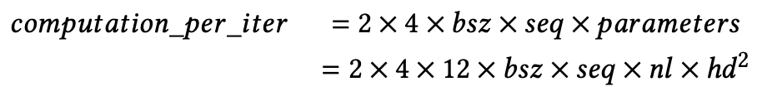
Bandwidth Requirement
Total Computation per Iteration
Calculate AIT in each state
𝑠𝑒𝑞 × 𝑏𝑠𝑧 (Parameters and Gradients)
Forward + backward + recomputation in backward + gradients store in final location, totally 4 * num_parameters * sizeof(FP16)
𝑠𝑒𝑞 × 𝑏𝑠𝑧/4 (Optimizer States)
Read + write, totally 2 * 4 * num_parameters * sizeof(FP32)
24 × h𝑑 × 𝑐𝑖 (Activation Checkpoints)
2×𝑡𝑜𝑡𝑎𝑙_𝑎𝑐𝑡𝑖𝑣𝑎𝑡𝑖𝑜𝑛_𝑐h𝑒𝑐𝑘𝑝𝑜𝑖𝑛𝑡𝑠_𝑖𝑛_𝑏𝑦𝑡𝑒𝑠,

